Slide 1

ACHIEVING AFRICA'S TRADE INTEGRATION
THROUGH DIGITAL INNOVATION
Platforming Economies Sector by Sector
West Africa IMT | CEO, Matta

Slide 2

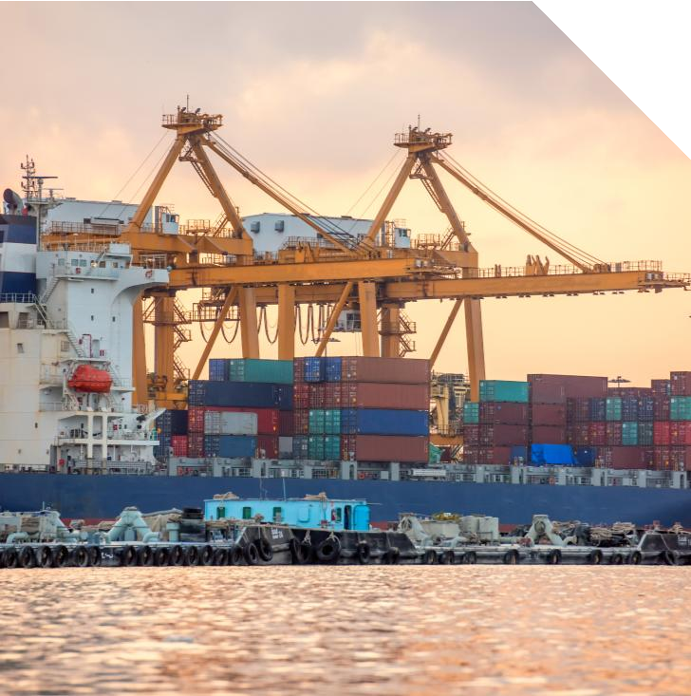



Africa’s Trade Paradox
Africa produces.
Africa consumes.
Yet the full potential of intra-African trade remains untapped.
This is not a failure of ambition. It is an opportunity to strengthen visibility, coordination, and execution across markets.
African economies often source externally not because regional supply does not exist — but because structured visibility across borders remains limited.
When visibility improves, trade flows more efficiently.

Slide 3



The Scale of the Opportunity
$3.4T
Combined GDP
across 54 nations
1.4B
People on
the continent
60%
Population
under 25
$450B
Annual imports much source able locally
Africa has the resources, the people, and the demand.
What it lacks is the digital infrastructure to connect them.
Sources: World Bank National Accounts Data 2024; UN Population Division 2024; UNCTAD Handbook of Statistics 2024.

Slide 4




The Trade Paradox
~15%
Intra-African trade
vs. 60% in Asia-Pacific
vs. 67% in Europe
$33T
Global trade value in 2024
Africa captures a
fraction of this
$450B
Africa's annual imports
Much could be sourced
from the next country
The paradox is not that Africa cannot trade.
It is that Africa cannot see what it has, what it needs, or who can supply it.
Source: UNCTAD 2024, Afreximbank African Trade Report 2024.

Slide 5




The Real Constraint: Visibility
Supply exists — but is invisible
African producers manufacture goods across dozens of sectors. But no structured, digital record of what is available, in what quantity, at what quality, or at what price exists at the national level. In West Africa, regional demand served for years from Europe shifted to intra-regional supply once that supply became visible and credible. The market corrected itself. All that was needed was to remove the information asymmetry.
Demand exists — but is unstructured
Manufacturers, institutions, and governments import billions in goods annually. But this demand is fragmented across informal channels, brokers, and one-off relationships. No aggregated demand signal exists for producers to respond to.
Capital exists — but hesitates
Development finance institutions and private equity sit on billions earmarked for African trade. But without verified supply chains, transparent trade flows, and traceable settlement, capital cannot deploy at scale.
Sources: UNCTAD Economic Development in Africa Report 2023; Afreximbank African Trade Report 2024; AfDB African Economic Outlook 2024.
Page 5

Slide 6




The cost of the Invisibility
When trade participants cannot see each other, the consequences compound:
Persistent Import Dependency
Fragmented Supply Chains
Without structured digital supply visibility, supply chains remain informal, unreliable, and resistant to finance. Goods move through opaque broker networks.
In many cases, goods sourced externally could also be supplied regionally — creating an opportunity to strengthen intra-African trade while maintaining global trade partnerships.
Capital Flight & Missed FDI
Foreign direct investment requires transparency and predictable trade flows. When supply chains become visible and verifiable, capital can deploy with greater confidence and scale.
Industrialization Delays
You cannot industrialize what you cannot see. Local value addition, processing, and manufacturing stall when inputs are sourced internationally by default.
Sources: Afreximbank African Trade Report 2024; UNCTAD World Investment Report 2024; AfDB Industrialize Africa Strategy.
Page 6

Slide 7





What Must Change
From policy frameworks to digital execution infrastructure

Slide 8



Trade Integration is Infrastructure
What Africa Has Built
AfCFTA — the world's largest free trade area Bilateral and regional trade agreements Customs harmonization protocols
Rules of origin frameworks
Trade policy institutions across 54 nations
What is Still Missing
A digital layer that makes supply visible
Structured, aggregated demand signals Verified, traceable logistics and custody Disciplined, data-backed trade finance Transparent cross-border settlement
Sources: AfCFTA Secretariat; African Union Agenda 2063; UNECA Digital Trade Report 2024

Slide 9




Platforming Economies Sector by Sector
The solution is not another marketplace or logistics app. Platforming an economy means digitising the structural reality of what a nation produces, what it consumes, and how goods and capital move between its borders—and making that reality visible, verifiable, and actionable in real time.
Digitize National Supply
Structure Demand
Control Logistics
Govern Trade Data

Slide 10
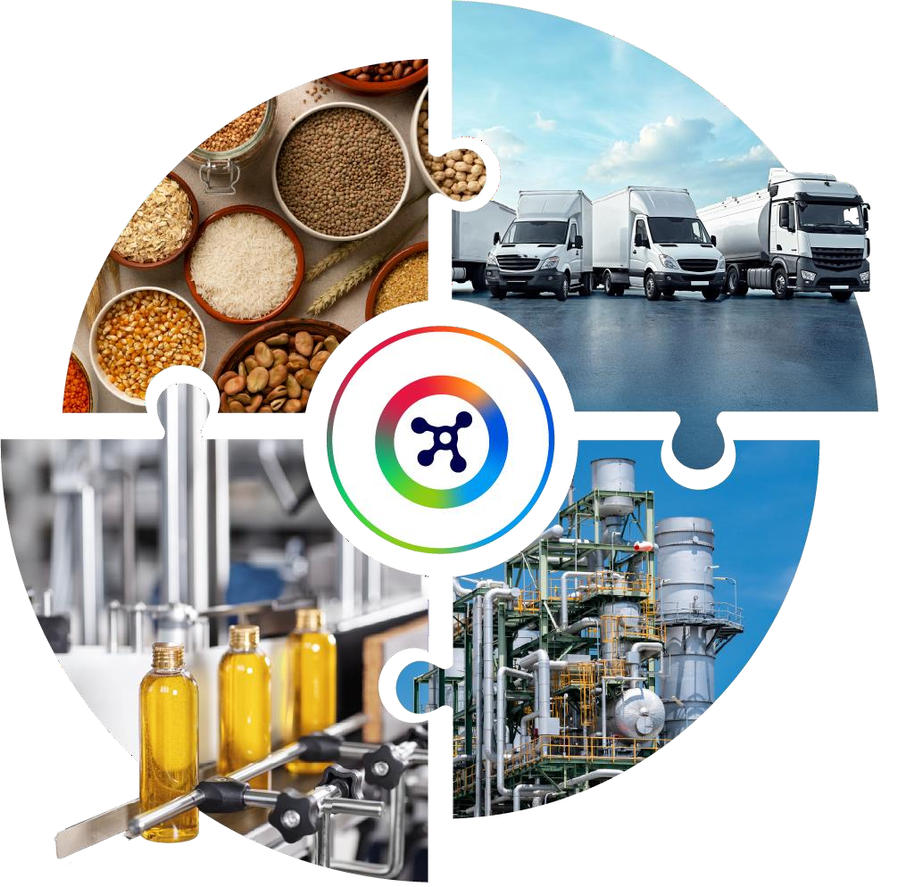
The Solution
Digital Trade Infrastructure for Africa
Matta is not a marketplace. It is the architecture of trust for African trade—digitizing and platforming production, procurement, logistics, and settlement so that governments and market participants can see what exists, verify it, move it, finance it, and settle it transparently.

Slide 11














The Matta Ecosystem
Supplier operating system verified onboarding &
storefronts
Finance governance condition-based capital deployment
Logistics control fleet management & shipment tracking
Procurement infrastructure API-driven enterprise integration
Structures demand B2B discovery for industrial
inputs
Settlement & compliance traceable cross-border fund flows

Slide 12


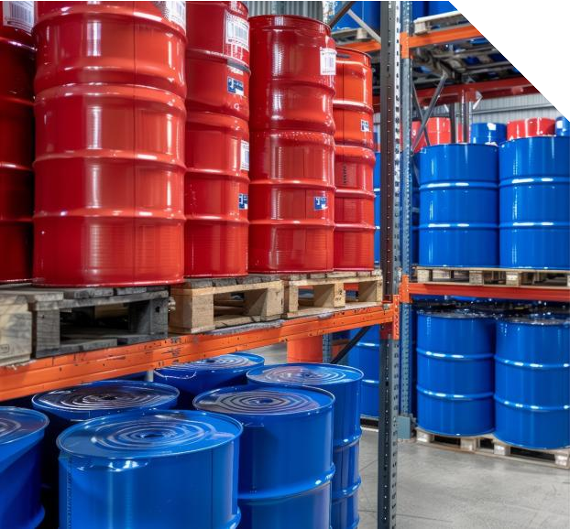
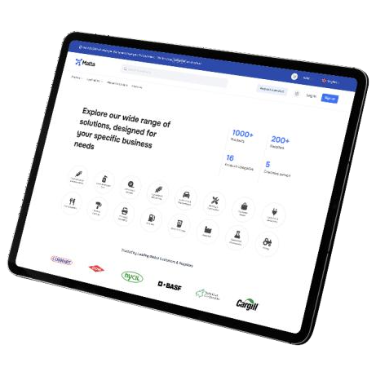

Matta Marketplace
Structured Demand
B2B marketplace purpose-built for industrial inputs across Africa. Transforms fragmented buyer needs into structured, predictable demand signals that the entire supply chain can respond to.
Product Discovery & Verification
Verified raw materials and industrial inputs searchable by category, origin,
specification, certification, and real-time availability.
Structured Sourcing Workflows
RFQ management, quote comparison, and order placement through standardized
digital processes — replacing phone-and-email procurement.
Demand Aggregation
Buyer needs across the platform are consolidated to create volume-based pricing,
predictable supply signals, and improved supplier planning.
Pricing Transparency
Real-time and historical pricing data gives both buyers and suppliers a fair,
transparent basis for negotiation and benchmarking.
Matta — Digital Infrastructure: The Future of African Trade

Slide 13



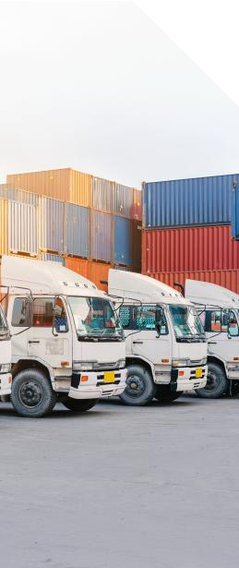
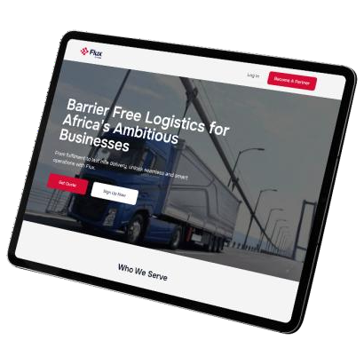

Flux
Logistics Control Layer
Bridges the gap between digital transactions and physical movement. Flux provides the logistics coordination layer that links every shipment to the trade data that authorized it — creating a verifiable chain of custody.
Fleet & Carrier Management
Carrier coordination, route planning, and capacity allocation across a multi-modal logistics network — road, rail, sea, and air.
End-to-End Shipment Coordination
Full shipment lifecycle management from pickup through customs clearance to final delivery, with automated milestone tracking.
Real-Time Tracking & Visibility
Live visibility into shipment location, status, and estimated delivery — available to buyers, suppliers, logistics providers, and financiers.
Transaction-Linked Validation
Physical delivery confirmation linked to the digital transaction record — creating the verified trigger for finance release and settlement.
Matta — Digital Infrastructure: The Future of African Trade

Slide 14



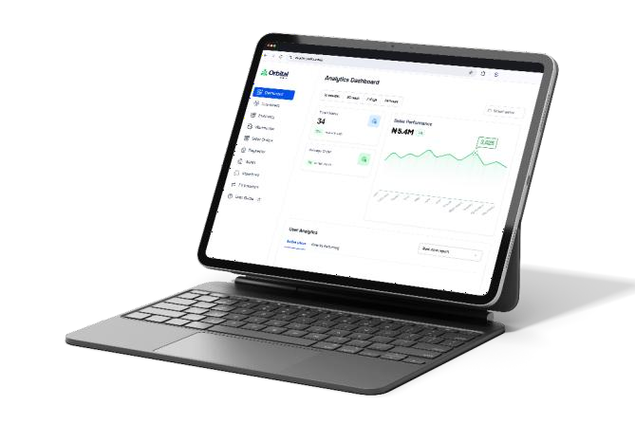
Orbital
Supplier Operating System
Gives suppliers the digital infrastructure to participate professionally in trade — verified identity, digital storefronts, structured
invoicing, and a performance history that unlocks financing and new buyer relationships.
Verified Onboarding & Compliance
Identity verification, capability assessment, and regulatory compliance checks before
suppliers enter the ecosystem — building trust from day one.
Digital Storefronts
Structured profiles with product catalogs, certifications, capacity information, and lead times — making every supplier discoverable and comparable.
Invoicing & Trade Documentation
Standardized digital invoicing, packing lists, and certificates of origin that feed directly into finance and settlement layers.
Performance History & Scoring
Track record of delivery reliability, quality consistency, and responsiveness — the data
foundation for finance eligibility and buyer confidence.
Matta — Digital Infrastructure: The Future of African Trade

Slide 15


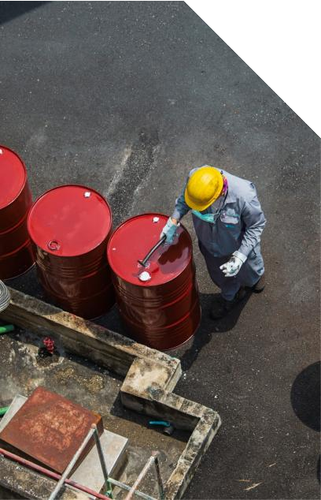

Polymer
Procurement Infrastructure
The procurement engine and API layer that integrates directly into enterprise systems. Polymer structures recurring demand and enables programmatic trade corridors — turning ad-hoc purchasing into systematic, data-driven procurement.
Enterprise System Integration
APIs connect directly to ERP and procurement systems, eliminating manual re-entry, reducing sourcing cycle times, and creating a single source of truth.
Structured Recurring Demand
Transforms one-off purchases into repeatable, scheduled procurement flows that
suppliers can plan against — stabilizing entire supply chains.
Programmatic Trade Corridors
Automates supplier matching and trade route optimization across established corridors, with built-in compliance and documentation.
Procurement Analytics
Spend analysis, supplier performance tracking, and corridor-level insights that
drive continuous improvement in procurement efficiency.
Matta — Digital Infrastructure: The Future of African Trade

Slide 16


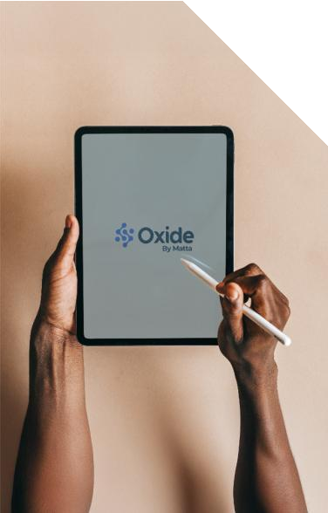

Oxide
Responsible Finance Deployment
The trade finance governance layer. Rather than deploying capital based on collateral alone, Oxide ties finance release to verified trade conditions
— expanding access to capital while reducing systemic risk across the ecosystem.
Condition-Based Finance Release
Capital is deployed when verified trade milestones are met — order confirmed, goods shipped, delivery validated. No milestone, no release.
Corridor-Level Exposure Management
Portfolio-level view of trade finance exposure across geographies, sectors, counterparties, and time horizons — enabling responsible scaling.
Risk Intelligence & Scoring
Transaction-level data feeds real-time risk models, replacing collateral-only
assessments with dynamic, trade-activity-based scoring.
Systemic Risk Reduction
By linking every dollar to a verified trade event, Oxide addresses the information
asymmetry at the heart of Africa's $450B trade finance gap.
Matta — Digital Infrastructure: The Future of African Trade

Slide 17





Osmosis
Settlement & Compliance
Completes the trade cycle. Ensures that settlement happens only upon verified delivery, with full regulatory alignment, traceable fund flows, and structured reporting across borders.
Traceable Fund Flows
Every payment is linked to a verified trade event, creating a complete audit trail
from order initiation through final settlement.
Cross-Border Regulatory Alignment
Built-in compliance with payment regulations, foreign exchange requirements, anti- money-laundering rules, and jurisdiction-specific reporting.
Verified Delivery Settlement
Funds release conditioned on confirmed delivery and quality acceptance —
protecting buyers, suppliers, and financiers alike.
Structured Reporting & Audit
Automated trade documentation and reporting that satisfies regulatory
requirements and supports institutional audit processes.
Page 17
Matta — Digital Infrastructure: The Future of African Trade

Slide 18


How the Ecosystem Works
Orbital
Verify Supply
Polymer
Aggregate Demand
Marketplace
Match Trade
Oxide
Deploy Capital
Flux
Move Goods
Osmosis
Settle Payments
The Story of a Single Transaction
A cocoa butter producer in Ivory Coast is verified and onboarded through Orbital. A cosmetics manufacturer in Nigeria posts recurring demand through Polymer. The Marketplace matches them. Oxide deploys working capital against the verified order. Flux manages physical delivery with inspection at origin, transit, and destination. Osmosis settles the cross-border payment in compliance with both countries' regulations.
Every step is visible. Every step is verifiable. Every step is governable.

Slide 19
















Matta at a Glance
$300M+
Value of goods sourced
1,000+
Transactions completed
1,000+
Suppliers onboarded
7
Countries with transactional presence
16 product categories across 8 sector verticals
Home & Personal Care
Food & Beverage
Oil & Gas
Pharmaceuticals
Agro-commodities
Minerals & Mining
Paints & Coatings
Building & Construction
Transactional Presence:
NIG
SOU
GHA
IVO
BEN
TAN
MAU

Slide 20




What Trade Integration Means for Africa's Future
Looking Ahead

Slide 21





What Changes for Governments
Revenue Enhancement
Formalized trade expands the tax base. Visible transactions reduce leakage. Governments collect revenue from previously invisible activity.
Industrialization Acceleration
Local manufacturers discover regional inputs at competitive prices. Import
substitution becomes organic. Value chains develop locally.
Trade Sovereignty & Oversight
Real-time visibility into trade flows, finance deployment, and settlement. Production
data by sector, compliance metrics, and corridor analytics.
Regional Corridor Development
Digital infrastructure transforms agreements into functioning corridors. AfCFTA moves from framework to execution.
Private Sector Growth
SMEs access regional markets. Large enterprises find verified supply. Jobs created across value chains.

Slide 22


Trade Visibility Unlocks Capital
When trade becomes visible, verifiable, and traceable, capital that has been waiting on the sidelines can finally deploy.
Risk Becomes Measurable
Verified supply chains mean investors
assess risk with data, not assumptions.
Corridors Become Assets
Functioning trade corridors are investable infrastructure—predictable, governable, scalable.
Jobs Scale with Trade
Each verified trade corridor creates hundreds to thousands of jobs across value chains.
Revenue Multiplies
FDI drives higher export volumes, expanded tax base, and sustained revenue growth.
Competitive Positioning
Nations that build trade visibility first become the hub for verified regional commerce.
Technology Transfer
International partners bring operational best practices and global market access.
When trade becomes visible, capital follows.
Sources: UNCTAD World Investment Report 2024; AfDB African Economic Outlook 2024; IFC Emerging Markets Compass 2024

Slide 23


The Africa 2035 Vision
What does achieving trade integration through digital innovation actually look like?
Africa Sourcing Africa First
When a manufacturer in Lagos needs raw materials, the first search is regional. Visible, verified African supply is the default.
1
Structured Regional Value Chains
Ivory Coast produces cocoa butter. Nigeria transforms it into cosmetics. Kenya packages and distributes. Each step visible, financed, and settled digitally.
2
Digitally Enabled Trade Corridors
Every major intra-African trade route has digital infrastructure: verified producers, predictable demand, controlled logistics, disciplined finance.
3
Globally Competitive Enterprises
African producers compete on quality and price with international suppliers—because they have the infrastructure to prove it.
4
This is not a 20-year aspiration. With the right infrastructure, elements of this vision are achievable within 5–10 years.
Page 23
Sources: African Union Agenda 2063; AfCFTA Protocol on Digital Trade; McKinsey Africa's Business Revolution 2023

Slide 24

Why Now is the Moment
1
Global supply chains are reshaping. Africa must position itself as a source, not just a
market.
2
AfCFTA implementation is accelerating. The framework exists— what's needed is execution infrastructure.
3
Digital trade infrastructure is the foundation for industrialization. Policy sets direction. Digital infrastructure delivers scale.
4
First movers will dominate corridors. Countries that build visibility first capture regional value chains.
5
As policy frameworks mature, infrastructure becomes the critical next lever for scale. It is now a question of operational capacity.
Sources: WTO Global Trade Outlook 2024; AfCFTA Secretariat Implementation Report; UNCTAD Technology and Innovation Report 2024

Slide 25



The Leadership Decision Before Us
Will Africa digitize trade —
or digitize dependency?
Build sovereign digital infrastructure that Africa owns
OR
Continue relying primarily on external platforms to intermediate African trade.
Will we export raw materials —
or platform value chains?
Use visibility to add value locally before export
OR
Continue exporting raw value without maximizing local value addition.
Will we integrate by policy —
or by infrastructure?
Build the digital layer that makes agreements executable.
Digitisation that embeds control strengthens sovereignty.
OR
Sign agreements without the systems to implement them. Digitisation must embed visibility and oversight to protect value.
Page 25

Slide 26

Trade integration does not need to be forced.
When visibility exists, integration follows.
And when integration follows, industrialization becomes an inevitability.
Let’s build together!

Slide 27




Digital Trade Infrastructure
for Africa
Thank You
West Africa IMT
+234 916 998 2193
commercial@matta.trade
corporate.matta.trade

