Slide 1
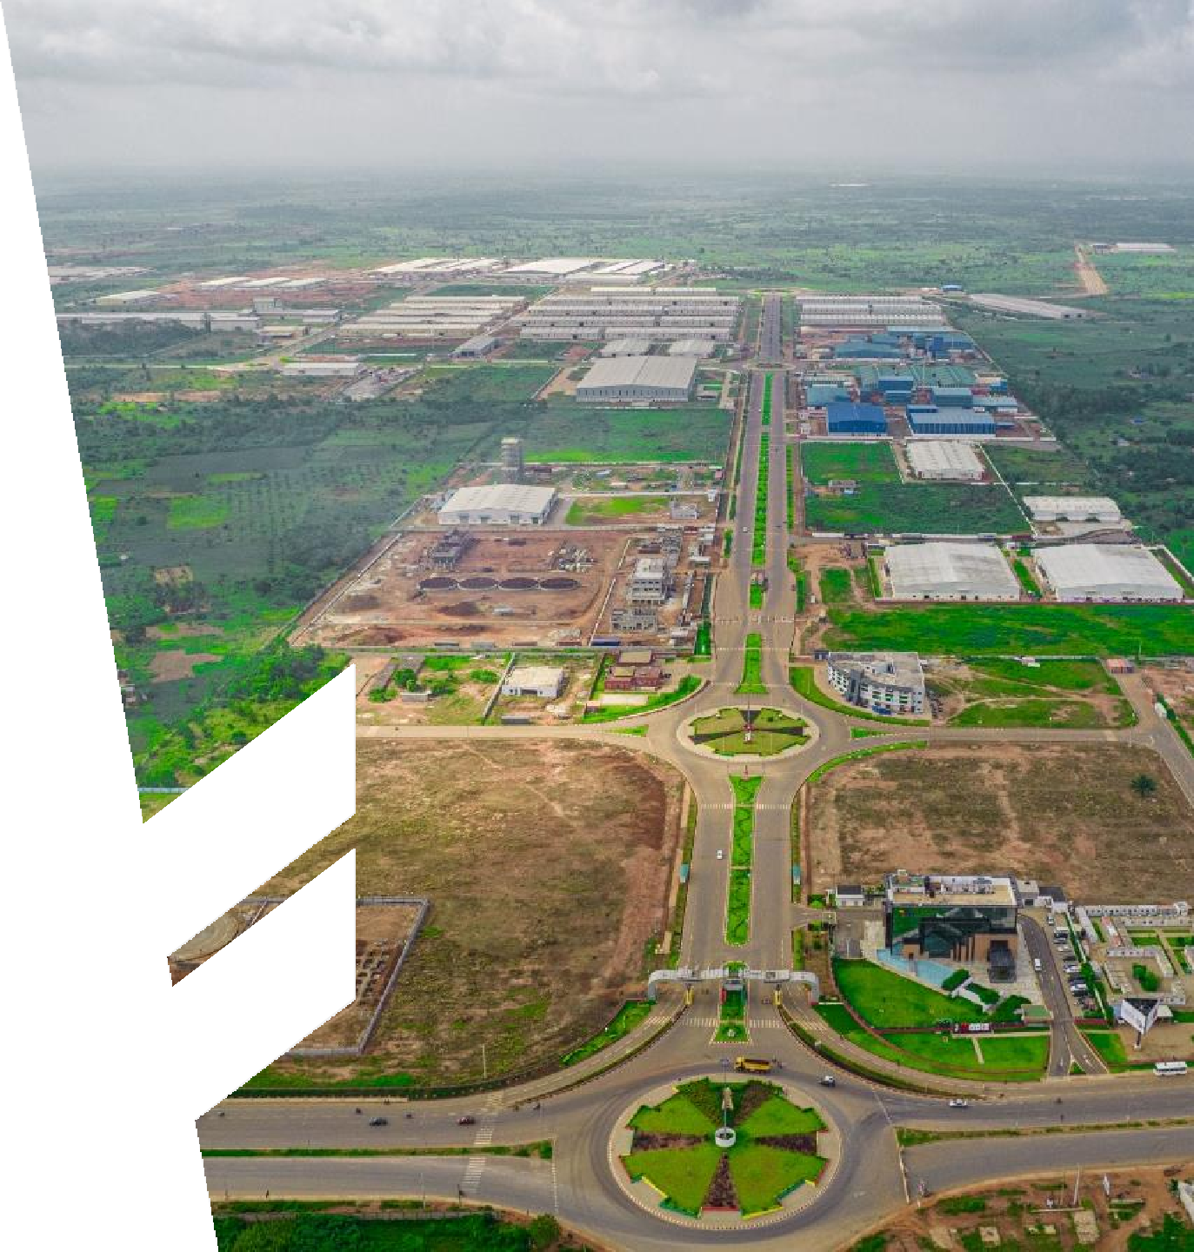


Glo-Djigbé Industrial Zone Zè-Bénin (GDIZ)
March 2026

Slide 2
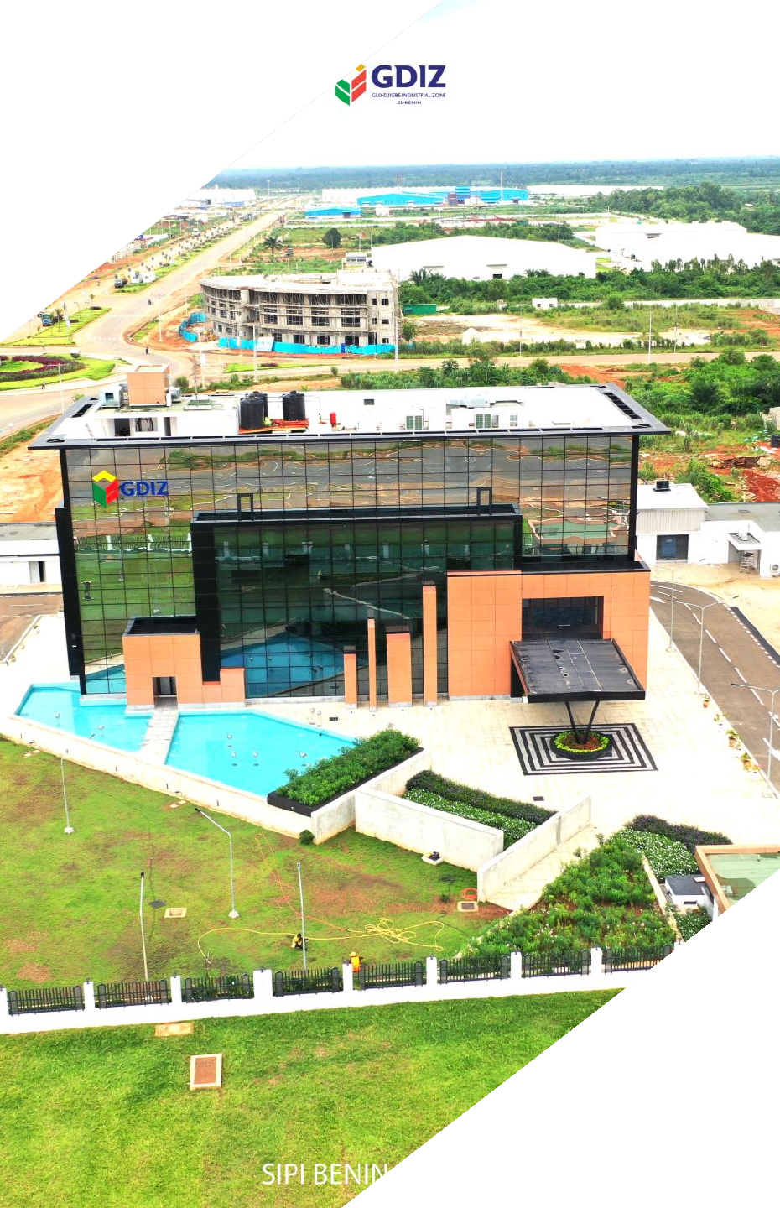
CONTENTS
01
02
03
04
05
SPECIAL ECONOMIC ZONE OF GLO-DJIGBÉ ZE BENIN(GDIZ)
MAIN VOCATIONS OF THE ZONE
INCENTIVE DISPOSAL APPLICABLE IN GDIZ
GOVERNANCE FRAMEWORK OF GDIZ
THE INFRASTRUCTURES AND
SERVICES PLANNED WITHIN GDIZ

Slide 3
01
SPECIAL ECONOMIC ZONE OF GLO-DJIGBÉ ZÈ-BENIN (GDIZ)

Slide 4



GLO-DJIGBÉ INDUSTRIAL ZONE (GDIZ)
Date of creation
February 5, 2020
by decree of the Council of
Ministers
Total Area
1640 hectares
Start of construction works
June 2021
Joint-Venture between
Republic of Benin and ARISE Group
technical partner in charge of planning, promotion, development and exploitation of GDIZ
Investment Amount for phase 1
164 billion XOF

Slide 5
02
MAIN VOCATIONS OF THE ZONE

Slide 6


MAIN VOCATIONS OF THE ZONE
Promote and attract agricultural, industrial,
commercial and service investments
Encourage direct investment, both Beninese and foreign
Foster the development of national production and natural resources
Develop the manufacturing industries of first, second and third transformation products
Increase the competitiveness of "Made in Benin" products
Promote job creation

Slide 7
03
INCENTIVE DISPOSAL APPLICABLE IN GDIZ

Slide 8
LAW N° 2022-38 OF 3 JANUARY 2023 ESTABLISHING THE REGIME OF SPECIAL ECONOMIC ZONES IN THE REPUBLIC OF BENIN
Regimes | 1. Export regime | 2-A. Regime for intra- community trade promotion (minimum investment 10 billion) | 2-B. Regime for intra- community trade promotion (investment>10 to 50 billion) | 2-C. Regime for intra- community trade promotion (investment >50 billion)
Benefits during investment process | Full exemption from import duties and taxes, except for road tax, statistical tax, customs stamp, community levy, community solidarity levy and solidarity levy on: equipment, tools and commercial vehicles exclusively for production purposes specific spare parts for imported equipment up to an amount equal to 15% of the value of the equipment's insurance and freight cost exemption from customs duties on raw materials under the export regime
Benefit during operational phase | 0 to 15 years: exemption from customs duties on raw materials exemption from corporate tax, profit tax installment and flat-rate minimum tax exemption from the contribution of business licenses and patents exemption from registration duty in case of capital increase exemption from employer's contribution to payroll tax Above 15 years : exemption from customs duties on raw materials common law regime with 15% corporate tax | 0 to12 years: exemption from corporate tax, profit tax installment and flat-rate minimum tax exemption from the contribution of business licenses and patents 50% discount on the amount of the employer's contribution to payroll tax Above 12 years : common law regime with 15% corporate tax. | 0 to 15 years: exemption from corporate tax, profit tax installment and flat-rate minimum tax exemption from the contribution of business licenses and patents 80% discount on the amount of the employer's contribution to payroll tax Above 15 years : common law regime with 15% corporate tax. | 0 to 17 years: exemption from corporate tax, profit tax installment, and flat-rate minimum tax exemption from the contribution of business licenses and patents exemption from employer's contribution to payroll tax exemption from registration duty in case of capital increase Above 17 years : common law regime for corporate tax.
Other benefits |  | Benefit of the Community certificate of origin for manufactured products
 | freedom of transfer of goods freedom and facilities to repatriate income and dividends freedom and facilities to transfer funds through licensed financial institutions freely negotiated labor contracts availability of production factors at competitive cost single window administrative facilities (including entry visas and resident permits)
8

Slide 9
04
GOVERNANCE FRAMEWORK
OF GDIZ
9

Slide 10


GOVERNANCE FRAMEWORK OF GDIZ
Regulatory
Administrative
JV Government -
Authority
Authority
ARISE
7 members
Head of the Single Window Clearance (SWC)
 |  | General Administrator
 |  | Deputy General
2 State’s representatives
1 Community representative
1 representative of the technical partner
Administrator
1 representative of SIPI – BENIN SA
Industrial
Logistics
Single Window Clearance
2 representatives of
Chamber of Commerce and Industry of Benin and the employers’ organisations of companies.
Commercial
Residential
10

Slide 11
05
INFRASTRUCTURES AND SERVICES PLANNED WITHIN GDIZ

Slide 12


















INFRASTRUCTURES AND SERVICES PLANNED IN GDIZ
Infrastructures SERVICES
INDUSTRIAL ZONE
COMMERCIAL AREA
RESIDENTIAL AREA
SINGLE WINDOW
WATER SUPPLY
ELECTRICITY SUPPLY
WASTE MANAGEMENT
CONTAINER TERMINAL TO FUNCTION AS A DRY PORT
TRUCK PARK
FIRE STATION
MEDICAL DISPENSARY
PROVISION OF OPTICAL FIBER
DEVELOPMENT OF ROADS
DEVELOPMENT OF CANALS
HOTELS
RESTAURANTS
PROFESSIONAL TRAINING SCHOOLS
DEVELOPMENT OF PIPELINES

Slide 13
06
PROGRESS OF CONSTRUCTION WORK

Slide 14
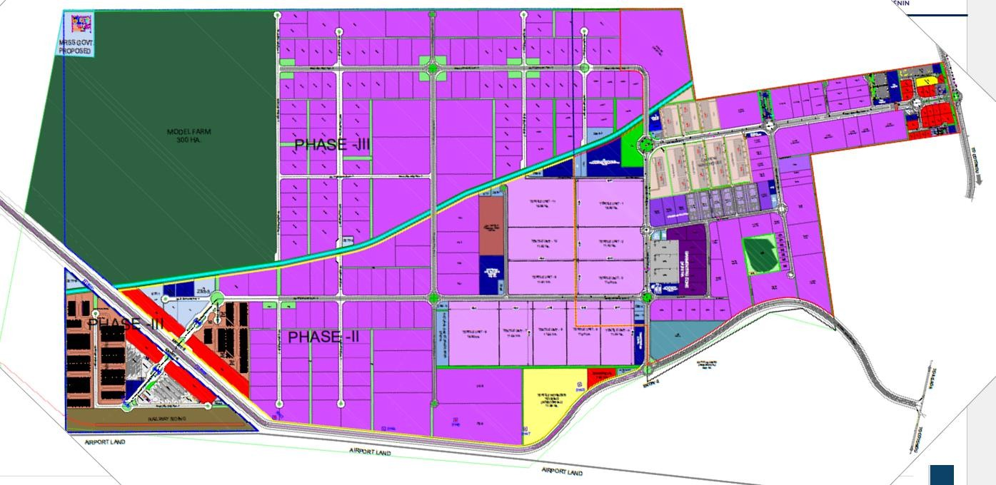
PROGRESS OF CONSTRUCTION WORK (1/3)
GDIZ : 1640 Ha IN 3 PHASES
PHASE III 840 Ha
PHASE I 400 Ha
PHASE II
400 Ha
Total: 1640 Ha

Slide 15

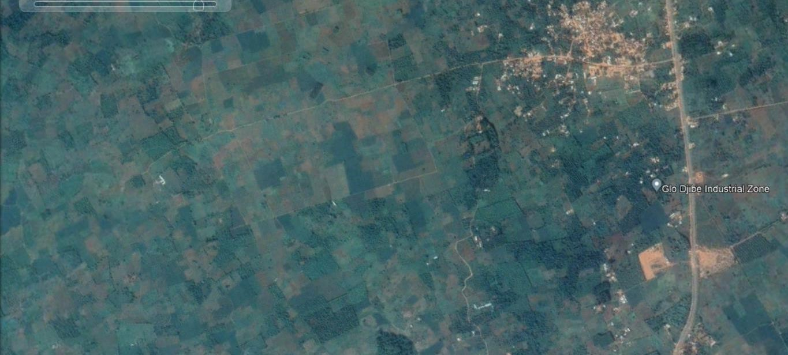
PROGRESS OF CONSTRUCTION WORK (2/3)
April 2021

Slide 16

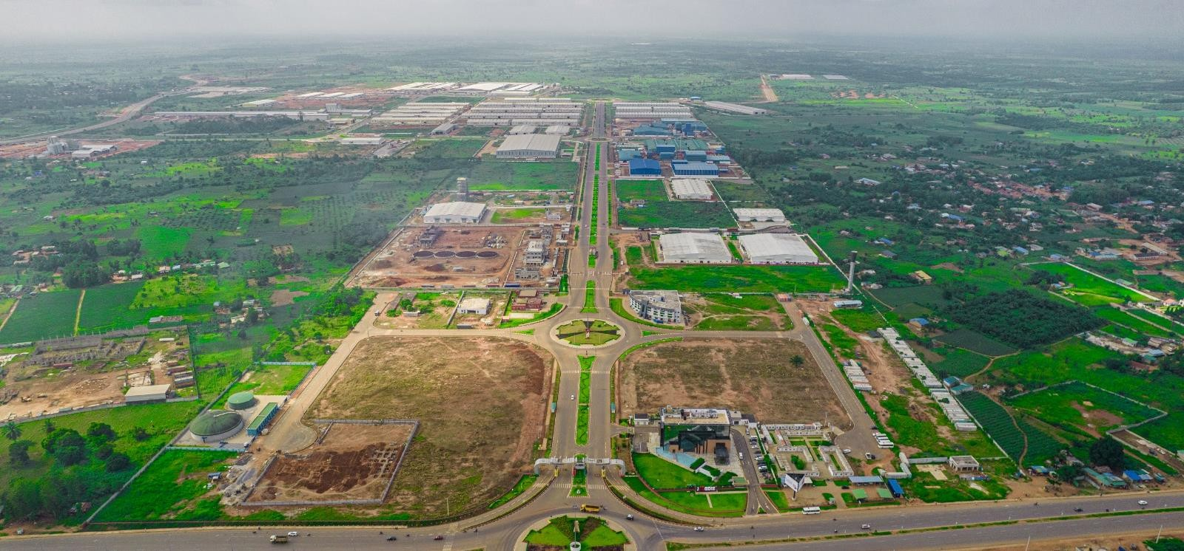
PROGRESS OF CONSTRUCTION WORK (3/3)
Year :
February 26
Location:
Glo-Djigbé Industrial Zone (GDIZ)
Cotonou
Allada
16

Slide 17
07
INVESTORS SIGNED IN PHASE I

Slide 18

36 INVESTORS HAVE ALREADY SIGNED WITH SIPI-BENIN S.A. TO INSTALL THEIR PRODUCTION UNITS WITHIN GDIZ.
NAP
TRT MANUFACTUTING
SYRRIUS INDUSTRIES
ARYATEX
CDF-AKAD
COMFORT MEUBLE
UNICARTON
AFROTEX GARMENTING
AFRIKAN CERAMICS SOLUTIONS
SOCIETE DES MABRES ET GRANITES DU BENIN
DHAZIRA BUSINESS CENTER
SoDeSeP
BENIN AGRI BUSINESS
BENIN ORGANIC
KRISHI AGRI
PROVENDES BENIN
CONCRETE SOLUTIONS BENIN (CSB)
NOVAREA
AK PETROLEUM
AGRO CAKE BENIN
EHUA INDUSTRIES SA
SOCIETE BENINOISE DE COSMETIQUES
(SOBECO)
LOGOCHEM
AFRITEX
BENIN WOOD FURNITURE
FHC MEDICA
FABRIQUE BENINOISE DE TABAC
JNP
B-STEEL
ORYX ENERGIE BENIN
ATLANTIC MOULIN BENIN
BENIN CASHEW
AFRICA JUTES BAGS
BENIN TEXTILE SA
BENIN TEXTILE CORPORATION
SOCIETE DES TEXTILES DU BENIN
RUBY ENERGY BENIN

Slide 19
08
FACTORIES ALREADY OPERATIONAL

Slide 20
FACTORIES ALREADY OPERATIONAL 1/7
15 factories already operational
+25 000
direct jobs already created
14 factories under construction or installation
+40 000
jobs expected by end of 2026
20

Slide 21
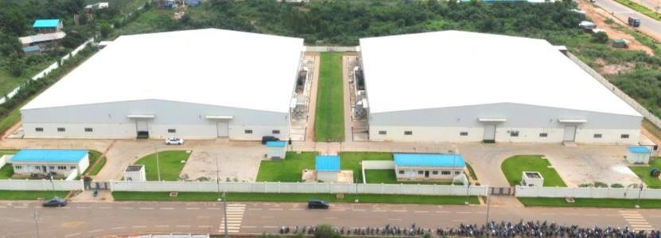
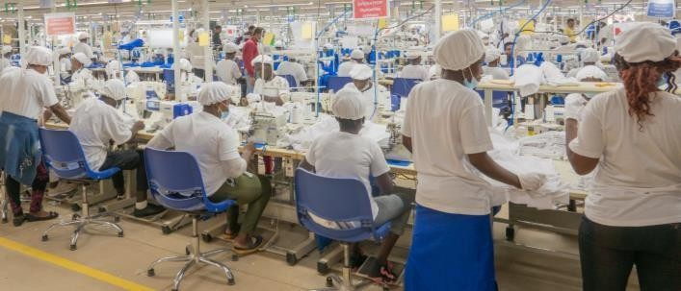
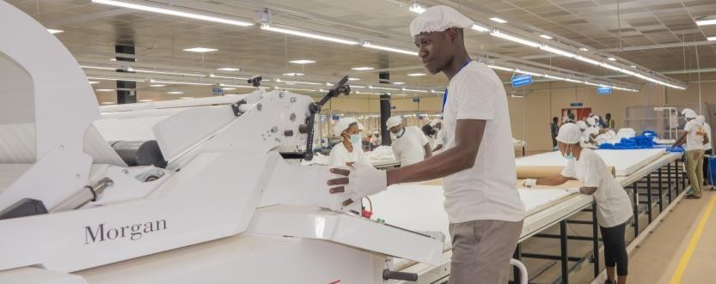
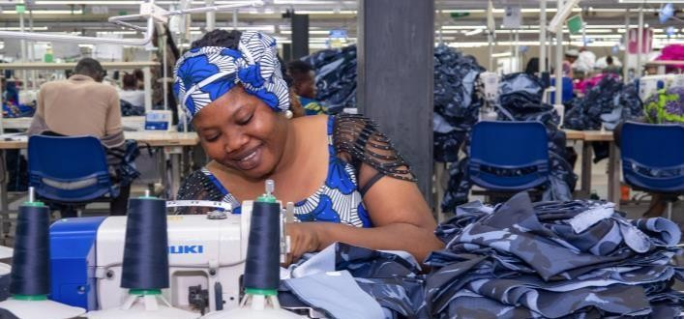
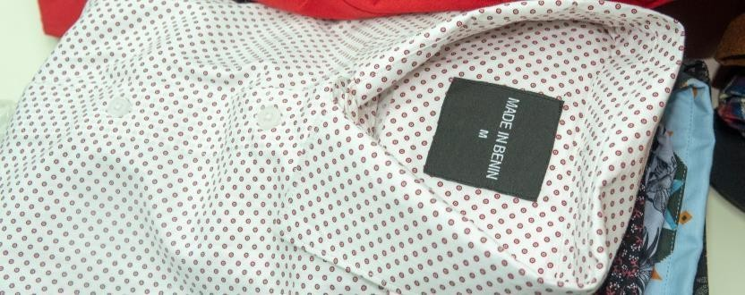

FACTORIES ALREADY OPERATIONAL 2/7
TEXTILE PRODUCTION UNITS
Activity: Garment training & production centers
Facilities : 02 centers
Finished products : ‘'Made in Benin’’ Polos, t-shirts, leggings, trousers, etc. for men, women & children
Number of jobs created: 3.000
First Clients : The Children's Place (TCP) - USA (leggings, polo shirts for girls and boys), The Republican Police, Customs, The Ministry of the Interior and Public Security; The Ministry of National Defence, SGDS, KIABI, US POLO ASSN, GEMO.
20

Slide 22
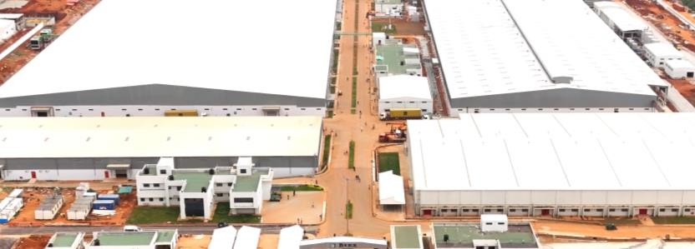
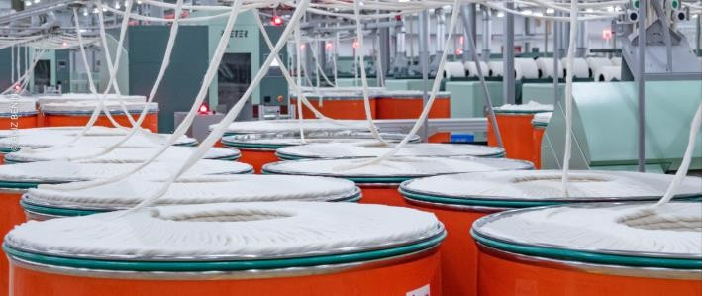
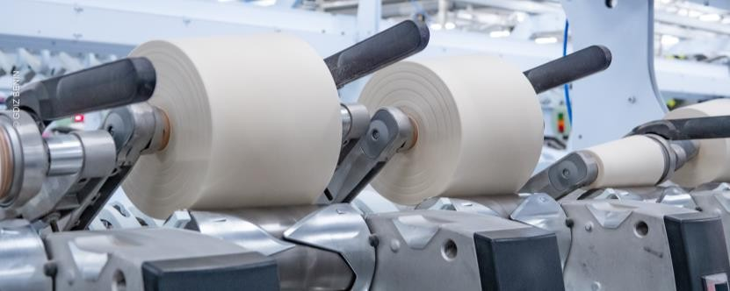
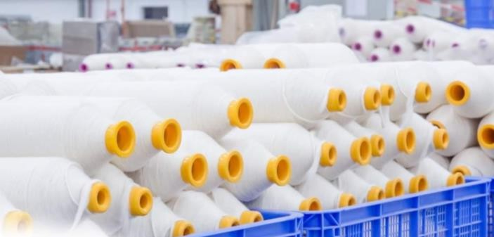
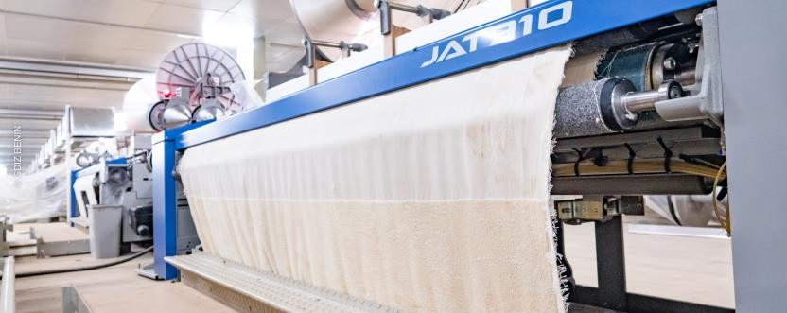

FACTORIES ALREADY OPERATIONAL 3/7
BENIN TEXTILE (Btex)
Activity: Integrated textile unit / cotton processing
Facilities : Spinning – weaving –
dyeing - finishing
Finished products : cotton yarns, towels & bed sheets
20

Slide 23
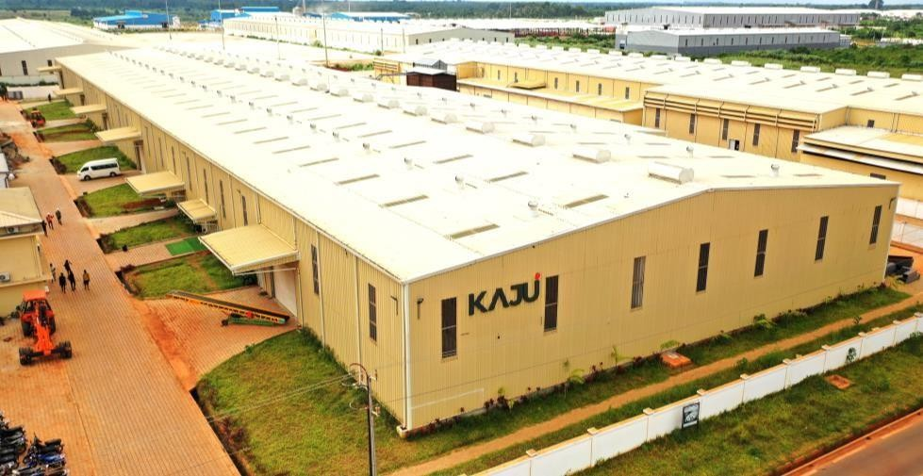
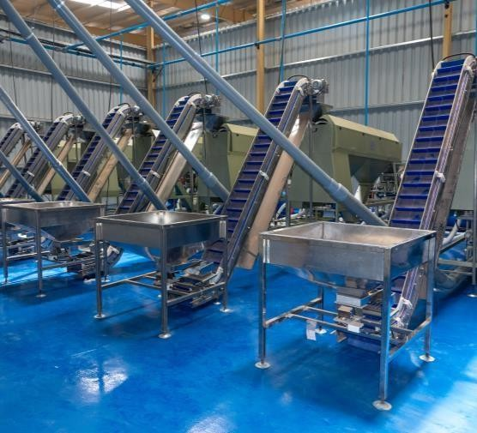
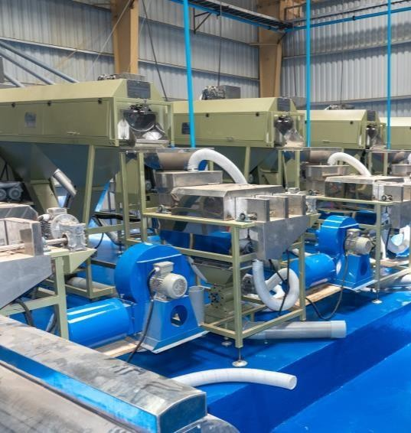
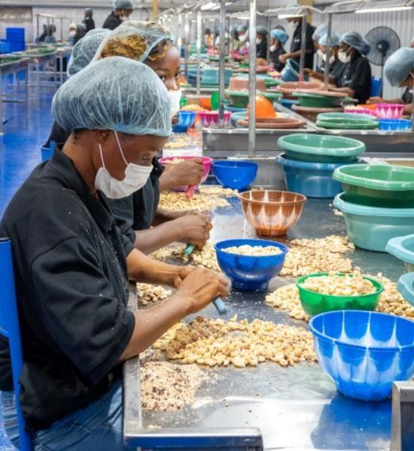
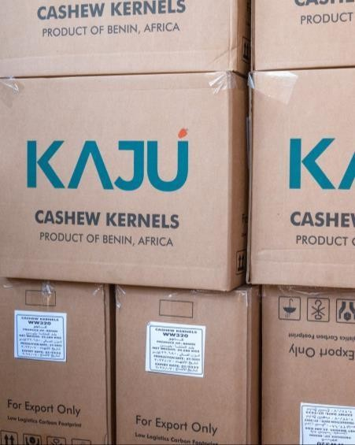
FACTORIES ALREADY OPERATIONAL 4/7
KAJU / BENIN CASHEW S.A.
Activity: Cashew nut processing Facilities: 05 production units Processing capacity: 120,000 tons of
raw cashew nuts per year
Finished products: Cashew kernels
Number of jobs created: + 2000 direct and 500 indirect
20

Slide 24
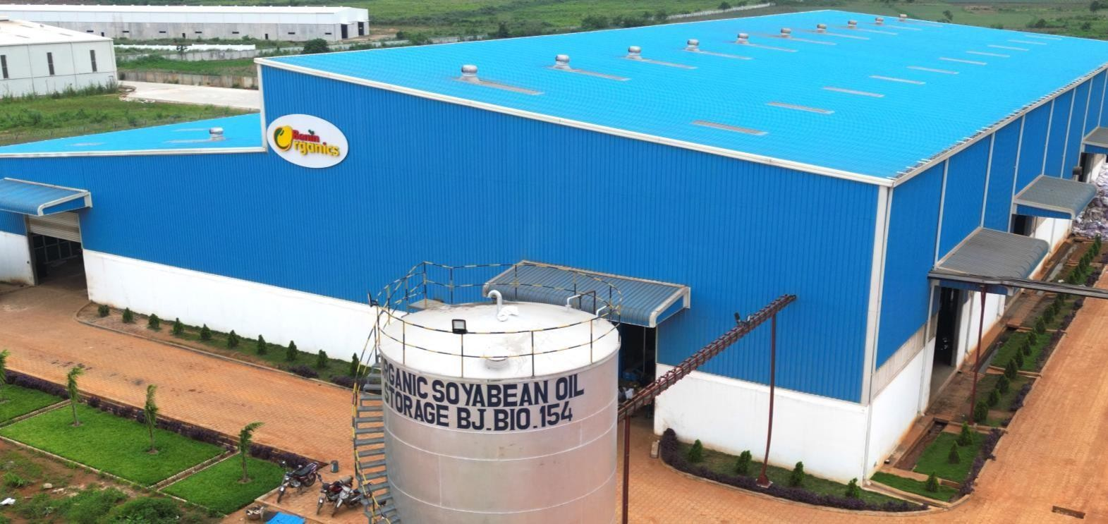
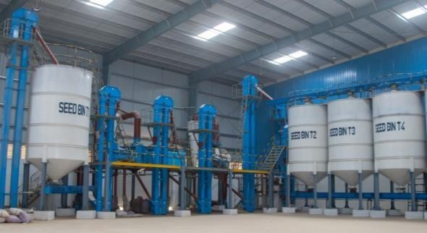
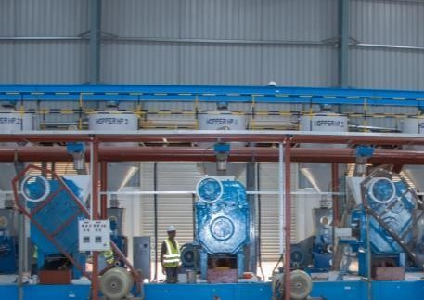
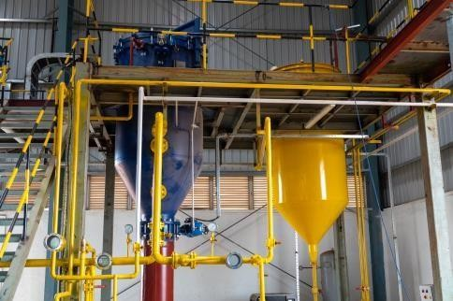
FACTORIES ALREADY OPERATIONAL 5/7
BENIN ORGANICS
Activity: Organic soybean processing
Facility: 01 production unit
Quantity of soybean already processed: 14,500 tons
Processing capacity: 60,000 tons per year
Finished products: Organic soybean oil & meal
Number of jobs created: 500
20

Slide 25
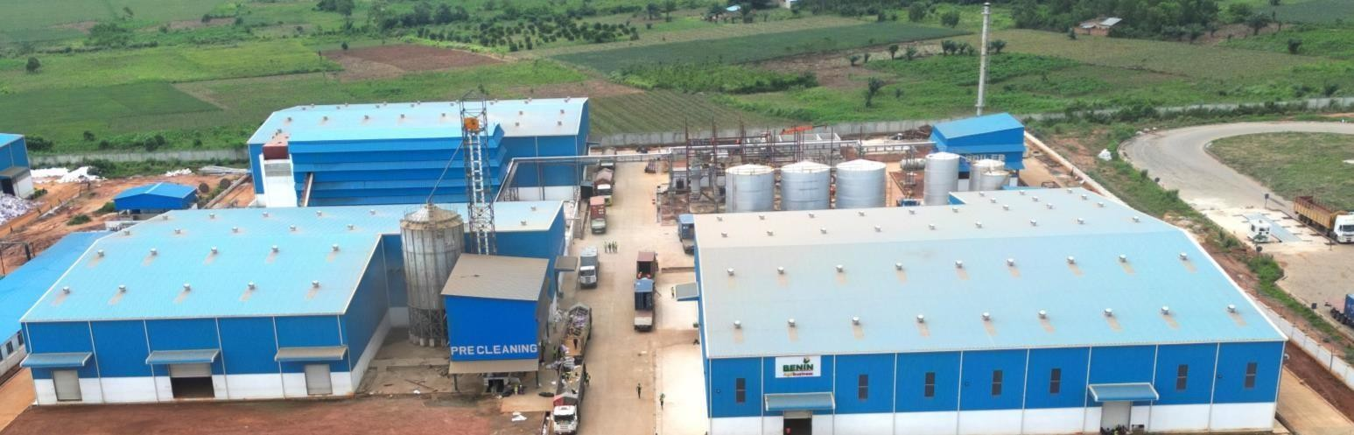
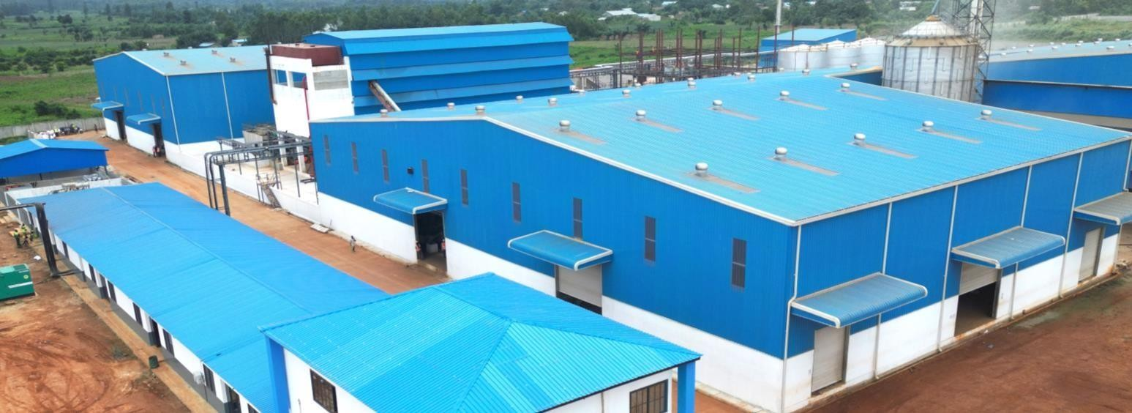
FACTORIES ALREADY OPERATIONAL 6/7
BENIN AGRI BUSINESS
Activity: Conventional soybean processing
Facility: 01 production unit
Quantity of soybean already
processed: 13,000 tons
Processing capacity: 150,000 tons per year
Finished products: Conventional soybean oil & meal
Number of jobs created: 500
20

Slide 26
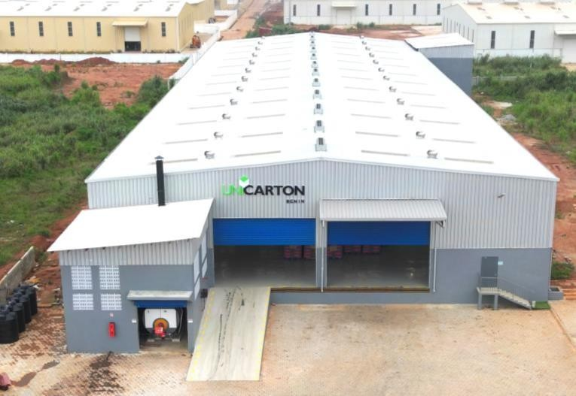
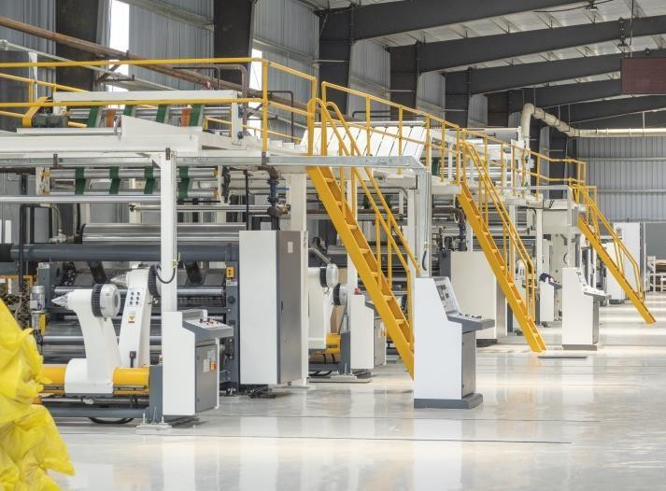
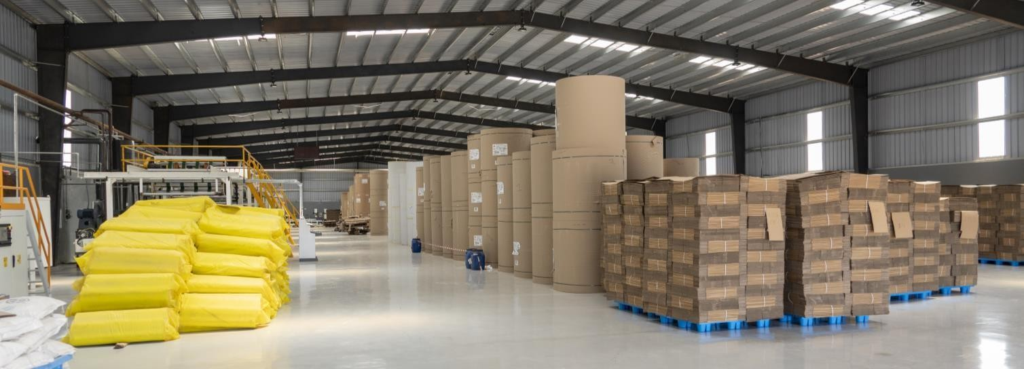
FACTORIES ALREADY OPERATIONAL 7/7
UNICARTON BENIN
Activity: Cardboard packaging manufacturing
Facility: 01 production unit
Finished products: Cardboard packaging in various shapes
Projected number of jobs: 300
20

Slide 27
09
BECOME AN INVESTOR

Slide 28

BECOME GDIZ INVESTORS
Process
STEP 01
STEP 02
STEP 03
STEP 04
Presentation of an Industrial Investment Project
Signature of Reservation Contract
Application for approval
Signature of the lease contract

Slide 29
10
EXPECTED IMPACTS OF GDIZ ON THE ECONOMY OF BENIN

Slide 30



JOB CREATION
100 000 jobs expected in the processing of cashew nuts, shea nuts, pineapples, soybeans, etc.
200 000 to
250 000 jobs expected
in spinning, cotton weaving and garment manufacturing
40,000 jobs expected by end of 2025.
300 000 jobs
expected by 2030.

Slide 31

IMPACTS ON EXPORTS AND GDP
Increase exports by 5 to 10 billion US dollars within ten
(10) years
Increase GDP by
4 to 7 billion US
dollars by 2030
Increase Benin's manufacturing output by 500%

Slide 32







