Slide 1

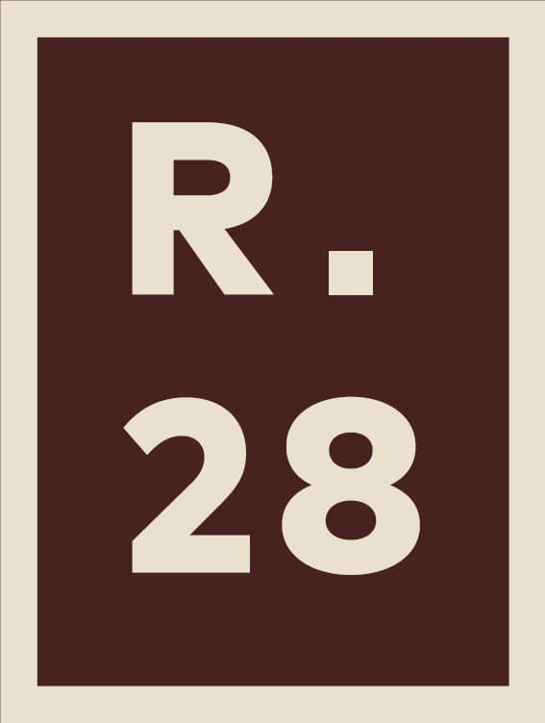



LEADING AFRICA'S MANUFACTURING
THROUGH
ENVIRONMENTALLY RESPONSIBLE PRACTICES
Mr. Adebisi Adebutu
Group President,
R28 Holdings Limited
Presentation at the
West Africa Industrialization and Manufacturing Trade Summit and Exhibition
4TH MARCH 2026

Slide 2
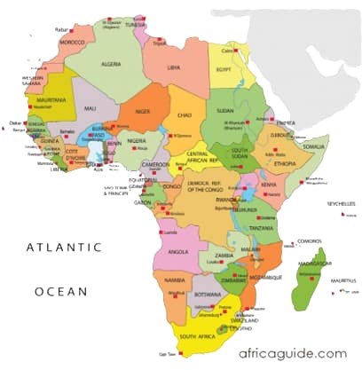





Africa’s Manufacturing Hubs
Africa’s Manufacturing Sector: Overview
Africa’s manufacturing sector currently contributes
  about 10–11% of the continent GDP and
  about 2% of global manufacturing output, reflecting steady but still limited industrial depth.
Production centres include South Africa, Egypt, Nigeria, and Morocco, with strengths in food processing, cement, automotive assembly, and basic consumer goods.
Contribution to Africa’s GDP
~11%
Africa’s contribution to Global Manufacturing output
~2%
Africa’s Manufacturing Strength
Food processing
Cement
Automotive Assembly
Basic Consumer goods

Slide 3
Access to single market of
1.4bn+ consumers
Africa’s Manufacturing Sector: Key Change Drivers
1
Key drivers of change include:
implementation of the African Continental Free Trade Area (AfCFTA), creating a single market of over 1.4 billion people with a combined GDP of about US$3.4 trillion.
Rapid urbanisation, (with Africa’s urban population expected to exceed 50% of the total population by 2030) is expanding demand for housing, infrastructure, and consumer goods.
Rising domestic consumption, driven by a population projected to reach 1.7 billion by 2030, is strengthening markets for locally manufactured products.
Increased infrastructure investment in transport, energy, and industrial parks is helping reduce logistics and production costs.
Africa’s Population will grow by
50%
of the current urban population by 2030
2
Infrastructure investment
US$100bn annually
(2016-2020)
3
Rising Domestic consumption by
1.7bn
people in 2030
4

Slide 4
Africa’s Manufacturing Sector: Key Constraints
The African Development Bank estimates that Africa needs between US$130bn and US$170bn annually to meet its infrastructure needs, but only about US$100bn is currently being invested per year, leaving a shortfall of roughly US$60bn to US$70bn each year.
US$150bn
Annual infra deficit
INFRASTRUCTURE
GAPS
Although Africa holds an estimated US$4trn in domestic institutional capital (pension and sovereign funds), only a small share is channelled into manufacturing and industrial projects due to risk perceptions, weak project pipelines, and regulatory barriers.
Africa has limited access to finance due to risk perceptions and regulatory barriers
LIMITED ACCESS
TO FINANCE
Africa handles only about 6% of global maritime trade, highlighting limited port capacity and connectivity issues. World Bank notes that inefficient logistics systems can increase the cost of goods by as much as 30–40 %, reducing competitiveness.
Africa handles only about 6% of global maritime trade due to limited capacity
LOGISTICS
BOTTLENECKS
In countries like Nigeria, the local currency (naira) depreciated by more than 60% between 2022 and 2024, deterring foreign capital due to difficulties in repatriating returns. Most transactions still clear through major foreign currencies like the U.S. dollar, exposing investors to exchange rate risk and high transaction costs
CURRENCY
VOLATILITY
High depreciation of local currencies against Forex

Slide 5
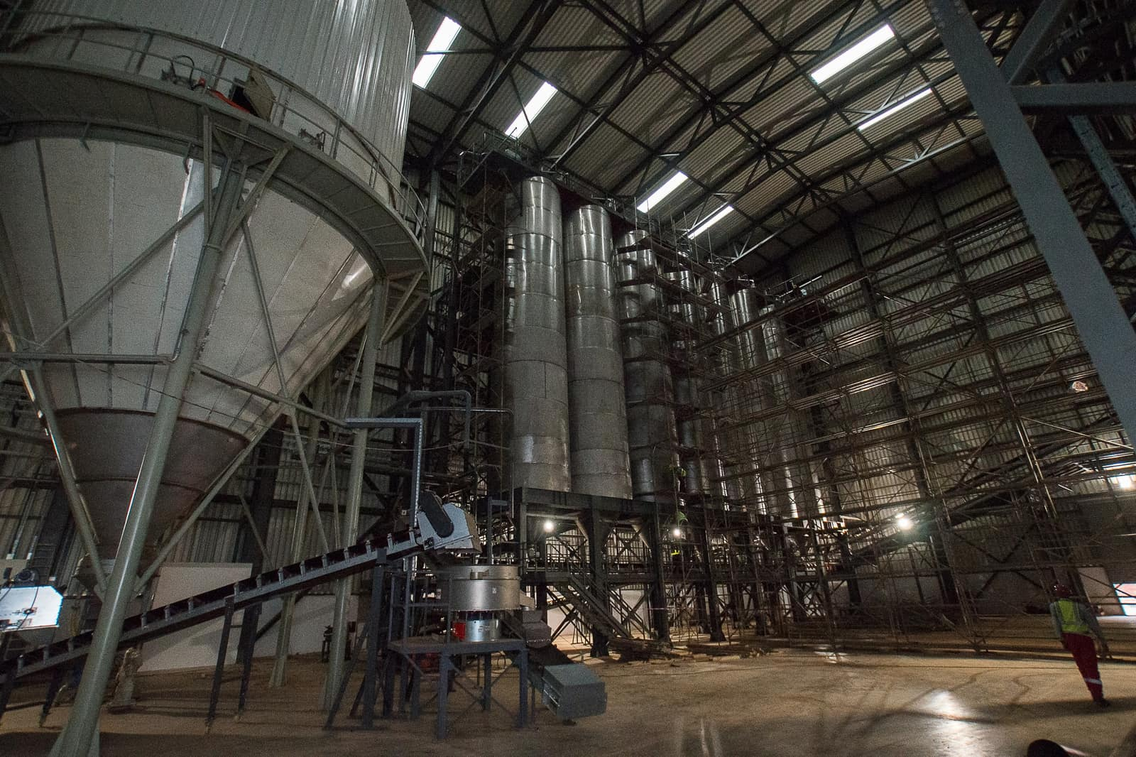
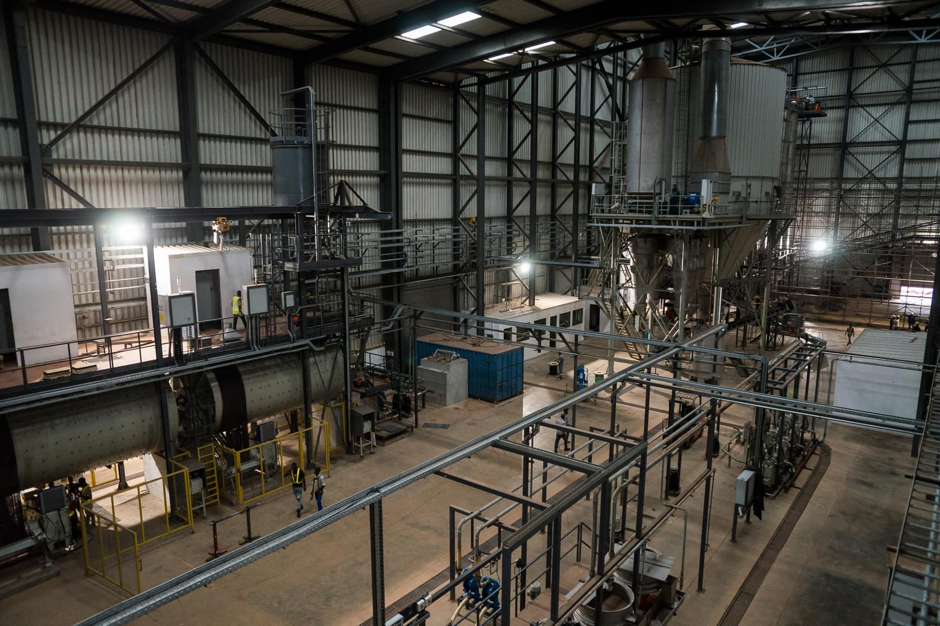
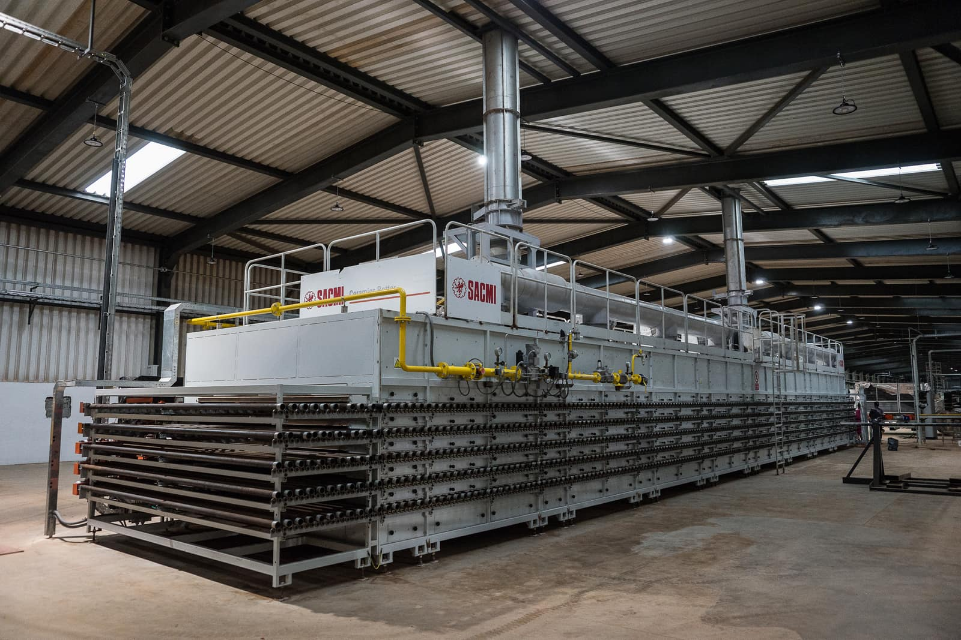
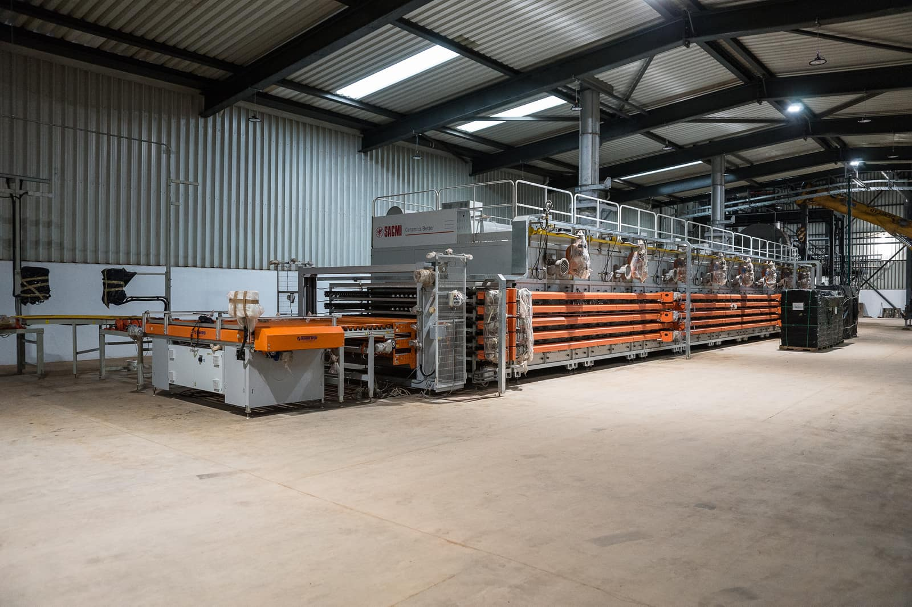
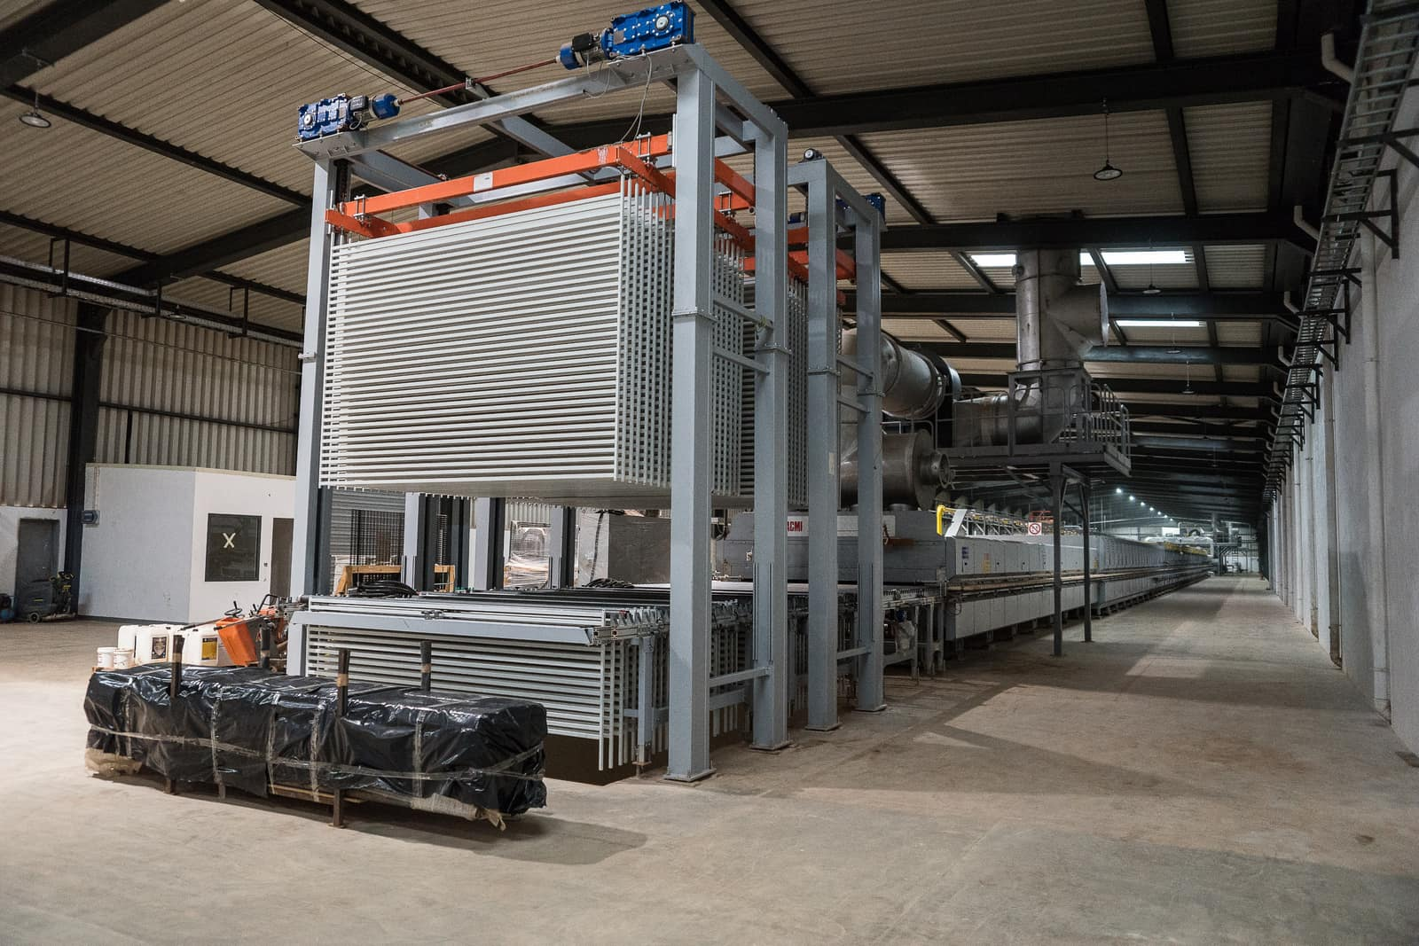
Africa’s Manufacturing Sector: Outlook 2026 - 2030
Deeper implementation of the AfCTA will boost intra-African trade and strengthen regional manufacturing value chains.
Export-oriented manufacturing will expand as countries seek to increase foreign exchange earnings and integrate into global supply chains.
Green industrialisation and renewable energy adoption will accelerate as firms respond to energy constraints and global ESG requirements.
Digitalisation and automation will gradually improve productivity, in leading economies such as South Africa, Egypt, Nigeria, and Morocco.
Despite persistent infrastructure and financing challenges, strong population growth and rising urban demand will support steady manufacturing expansion.

Slide 6
R28 Holdings Limited: Contributing Responsibly to Africa’s Manufacturing Sector
Adoption of energy-efficient machinery to reduce electricity consumption and lower carbon emissions.
Implementation of waste minimisation and material recycling programs within production processes.
Compliance with national environmental regulations and routine environmental impact monitoring.
Recycling of tile offcuts into the production cycle to reduce solid waste.
Installation of dust-control and air-filtration systems to minimise air pollution.
Water recycling systems for tile production and cooling processes.
Promotion of sustainable packaging and responsible resource management practices.
Compliance with national environmental regulations.
LEDCo’s NightSUN all-in-one solar luminaire demonstrates LEDCo’s commitment to environmentally responsible innovation by delivering zero-emission, energy-efficient lighting for businesses, streets and public spaces.
Its durable, low-maintenance design minimizes waste and operational costs over time,
Through public-private partnerships with Federal, State, and Local Governments, LEDCo aims to promote clean energy adoption, enhance public safety, and drive greener economic growth.

